Slide 1
Secure data hiding in images using steganography
CAPSTONE PROJECT
Presented By:
Student Name : Maddi Srinidhi
College Name & Department : Sri Indu College of Engineering and Technology & Cybersecurity

Slide 2
OUTLINE
Problem Statement
Technology used
Wow factor
End users
Result
Conclusion
Git-hub Link
Future scope

Slide 3
Problem Statement
Steganography hides secret data in images without noticeable changes, ensuring secure communication by concealing information. This method protects sensitive data from unauthorized access, making it a reliable approach for secure data transmission. Various techniques, such as Least Significant Bit (LSB) embedding, enhance security by subtly modifying image pixels. Due to its effectiveness, steganography is widely used in digital forensics, secure messaging, and confidential data exchange.

Slide 4
Technology used
Libraries:
OpenCV – For image processing and manipulation.
OS – To handle file operations and system interactions.
String – For text manipulation and encoding.
Platforms:
IDLE – Python's Integrated Development and Learning Environment.
Windows– Compatible operating systems for running steganography applications.
,

Slide 5
Wow factors
High Security: Uses encryption with steganography for double protection.
Adaptive Encoding: Dynamically selects the best method (LSB, DCT, or DWT) based on image properties.
Invisible to Detection: Resistant to steganalysis and common attack techniques.
Fast & Efficient: Optimized algorithms ensure minimal processing time.
User-Friendly Design: Simple, intuitive interface with automation for easy use.

Slide 6
End users
Government Agencies: For secure communication and classified data protection.
Journalists & Activists: To safely share sensitive information in restrictive environments.
Cybersecurity Professionals: For forensic analysis and secure data transfer.
Businesses & Enterprises: To protect confidential business documents and strategies.
General Users: For personal privacy and secure file sharing.

Slide 7
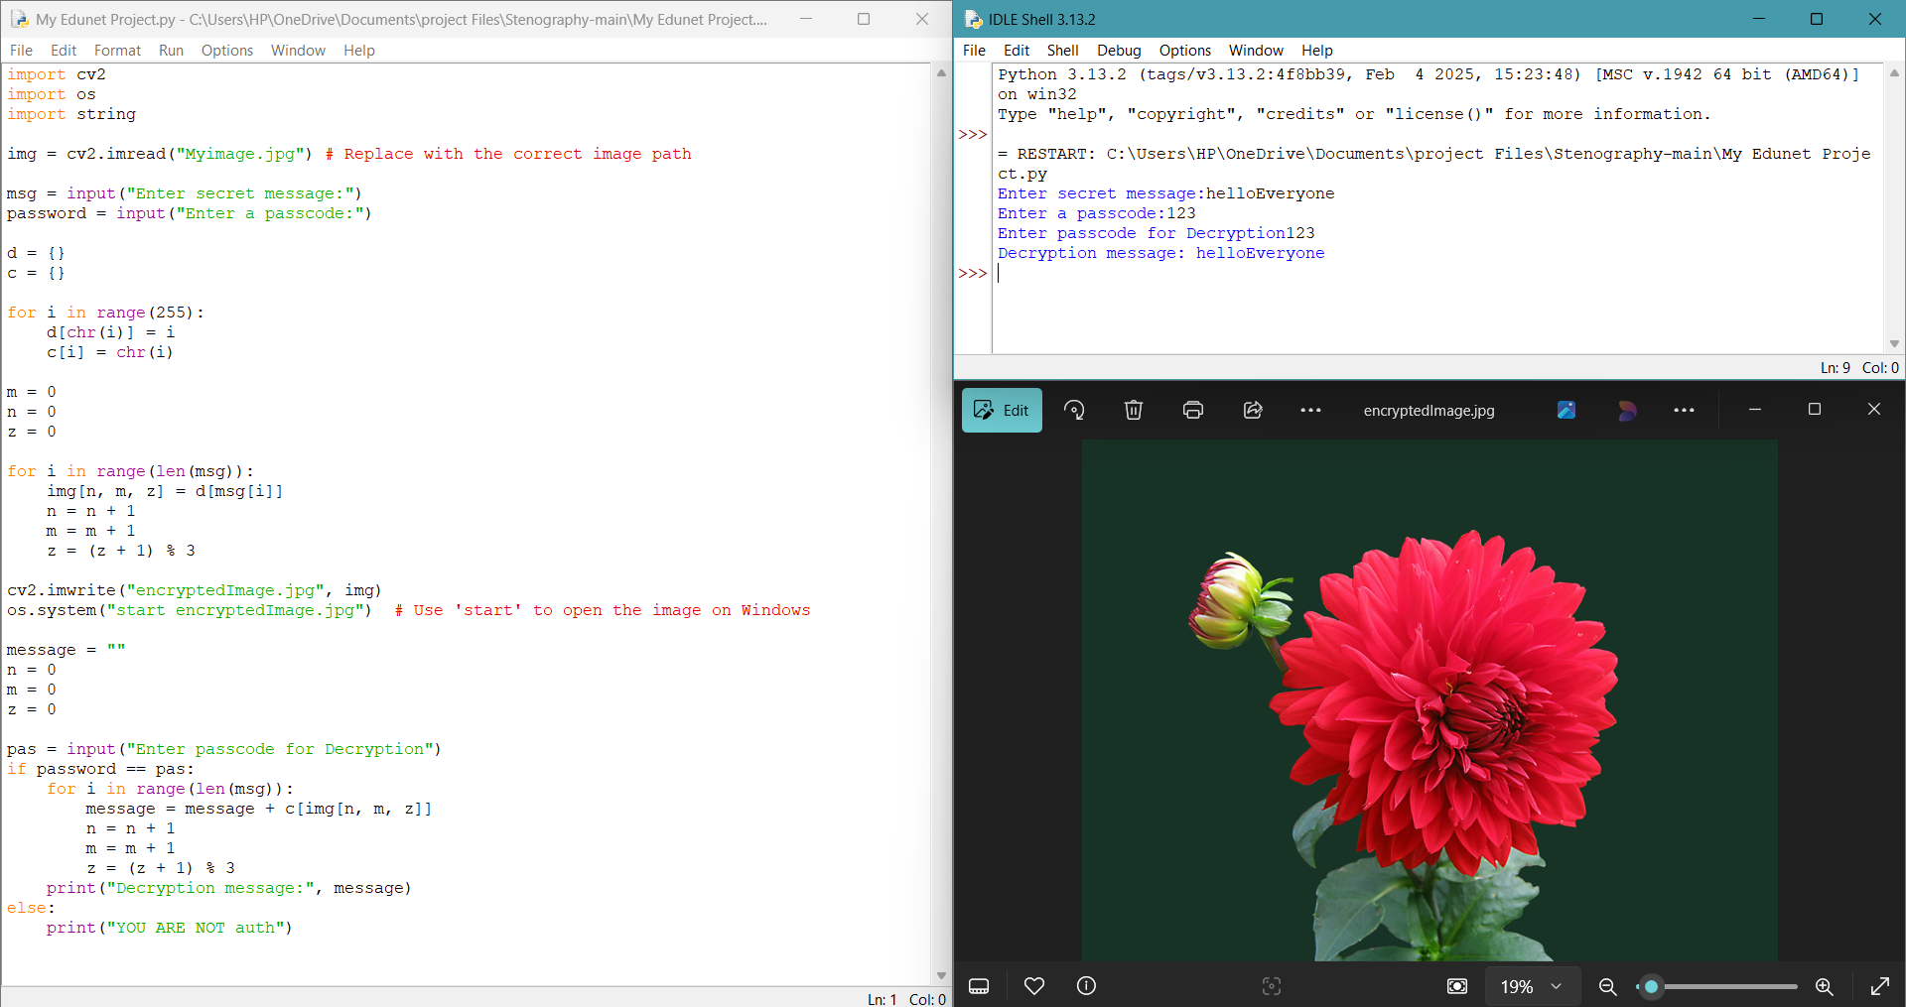
Results

Slide 8
Conclusion
This project successfully implements secure data hiding in images using steganography. By leveraging LSB embedding, it ensures efficient and undetectable information concealment. The approach enhances data security, protecting sensitive information from unauthorized access. Its applications in cybersecurity, digital forensics, and secure messaging demonstrate its real-world effectiveness. Overall, the project provides a robust solution for confidential communication.

Slide 9
GitHub Link
🔗 GitHub Repository:
https://github.com/srinidhireddy24/Steganography-Project-Srinidhi.git

Slide 10
Future scope
Enhanced Security: Implementing advanced encryption techniques to strengthen data protection.
AI Integration: Using machine learning to detect and prevent steganalysis attacks.
Cross-Platform Support: Expanding compatibility across various operating systems and devices.
Increased Capacity: Optimizing algorithms to embed larger data without noticeable image distortion.
Real-Time Applications: Applying the technique to secure real-time communication and cloud storage.

Slide 11
THANK YOU

